Slide 1
Linked List

Slide 2
Definition - List
A list is a collection of items that has a particular order
  It can have an arbitrary length
  Objects / elements can be inserted or removed at arbitrary locations in the list
  A list can be traversed in order one item at a time

Slide 3
List Overview
Linked lists
  Abstract data type (ADT)
Basic operations of linked lists
  Insert, find, delete, print, etc.
Variations of linked lists
  Singly linked lists
  Circular linked lists
  Doubly linked lists
  Circular doubly linked list

Slide 4
Linked List Terminologies
Traversal of List
  Means to visit every element or node in the list beginning from first to last.
Predecessor and Successor
  In the list of elements, for any location n, (n-1) is predecessor and (n+1) is successor.
  In other words, for any location n in the list, the left element is predecessor and the right element is successor.
  Also, the first element does not have predecessor and the last element does not have successor.

Slide 5
Linked Lists
A
B
C
∅
Head
A linked list is a series of connected nodes
Each node contains at least
  A piece of data (any type)
  Pointer to the next node in the list
Head: pointer to the first node
The last node points to NULL
node
A
data
pointer

Slide 6
Lists – Another perspective
A list is a linear collection of varying length of homogeneous components.
Homogeneous: All components are of the same type.
Linear: Components are ordered in a line (hence called Linear linked lists).
Arrays are lists..

Slide 7
Arrays Vs Lists
Arrays are lists that have a fixed size in memory.
The programmer must keep track of the length of the array
No matter how many elements of the array are used in a program, the array has the same amount of allocated space.
Array elements are stored in successive memory locations. Also, order of elements stored in array is same logically and physically.

Slide 8
Arrays Vs Lists
A linked list takes up only as much space in memory as is needed for the length of the list.
The list expands or contracts as you add or delete elements.
In linked list the elements are not stored in successive memory location
Elements can be added to (or deleted from) either end, or added to (or deleted from)the middle of the list.

Slide 9
Array versus Linked Lists
Linked lists are more complex to code and manage than arrays, but they have some distinct advantages.
  Dynamic: a linked list can easily grow and shrink in size.
    We don’t need to know how many nodes will be in the list. They are created in memory as needed.
    In contrast, the size of a C++ array is fixed at compilation time.
  Easy and fast insertions and deletions
    To insert or delete an element in an array, we need to copy to temporary variables to make room for new elements or close the gap caused by deleted elements.
    With a linked list, no need to move other nodes. Only need to reset some pointers.

Slide 10
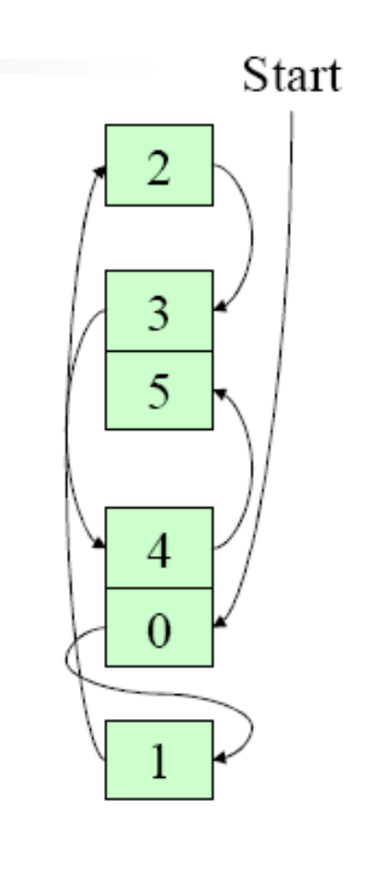
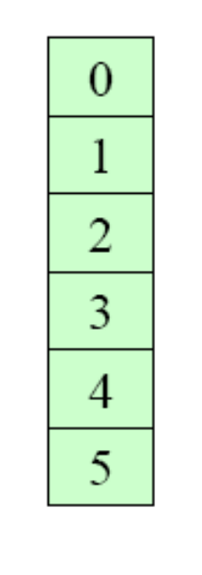
An Array
A Linked List

Slide 11
Basic Operations of Linked List
Operations of Linked List
  IsEmpty: determine whether or not the list is empty
  InsertNode: insert a new node at a particular position
  FindNode: find a node with a given value
  DeleteNode: delete a node with a given value
  DisplayList: print all the nodes in the list

Slide 12
An integer linked list
First Node of List
Last Node of List
list
10
13
5
2
data
next
NULL

Slide 13
Creating a List node
struct Node {
int data; // data in node
Node *next; // Pointer to next node
};
Node *p;
p = new Node;
p - > data = 10;
p - > next = NULL;
p
10

Slide 14
The NULL pointer
NULL is a special pointer value that does not reference any memory cell.
If a pointer is not currently in use, it should be set to NULL so that one can determine that it is not pointing to a valid address:
int *p;
p = NULL;

Slide 15
Adding a node to a list
Node *p, *q;
p = new Node;
p - > data = 10;
p - > next = NULL;
q = new Node;
q - > data = 6;
q - > next = NULL;
p - > next = q;
p
10
q
6
p
10
6
q

Slide 16
Accessing List Data
Node 1
Node 2
p
10
6
Expression
p
p - > data
p - > next
p - > next - > data
p - > next - > next
Value
Pointer to first node (head)
10
Pointer to next node
6
NULL pointer

Slide 17
Linked List
struct List{
int item;
List * next;
};
List * head = NULL;
void insert(int x){
List * temp = new List;
temp->item = x;
if (head== NULL){
temp->next = NULL;
head = temp;
}
else{
temp->next=head;
head = temp;
}
}
void delete(){
Node * temp = head;
if (head == NULL){
return;
}
else{
head = head->next;
delete temp;
}
}
void main(){
insert(10);
insert (20);
insert (40);
delete();
}

